Slide 1
Communicating with Data – Detail and Context
Dr. Ab Mosca (they/them)
Slides based off slides courtesy of Jordan Crouser (https://jcrouser.github.io/)

Slide 2
Plan for Today
Multiple datasets
Customizing the look of a visualization
Adding custom icon sets
Working with filters
Conditional backgrounds
Adding images
Details on demand (external resources)

Slide 3
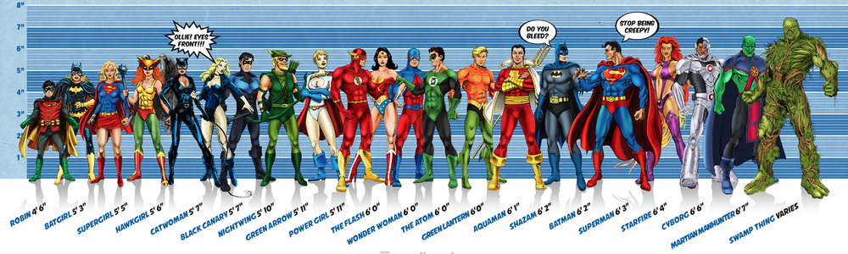
Running example: superheroes
Image credit: Ming Malaykham

Slide 4
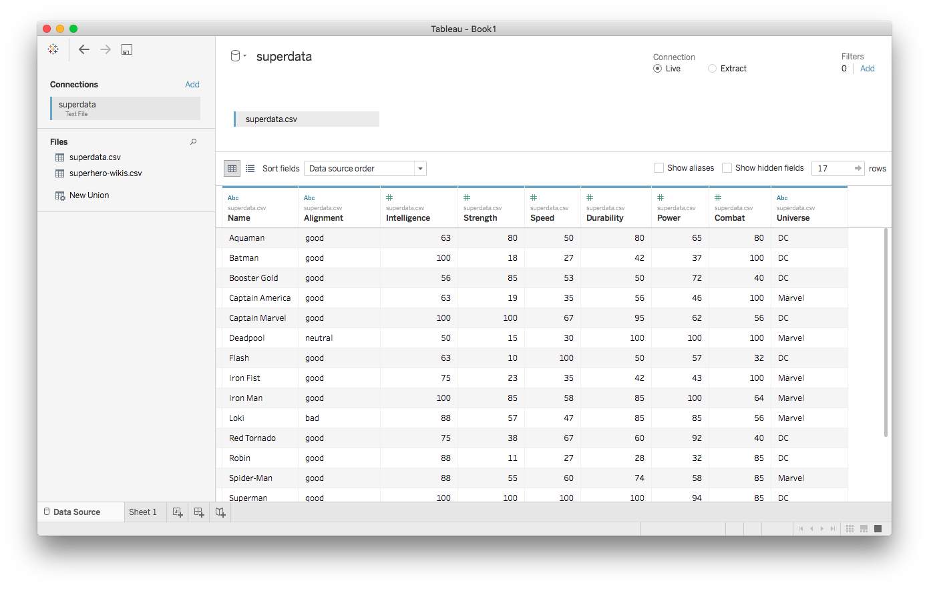
First dataset: superdata.csv

Slide 5
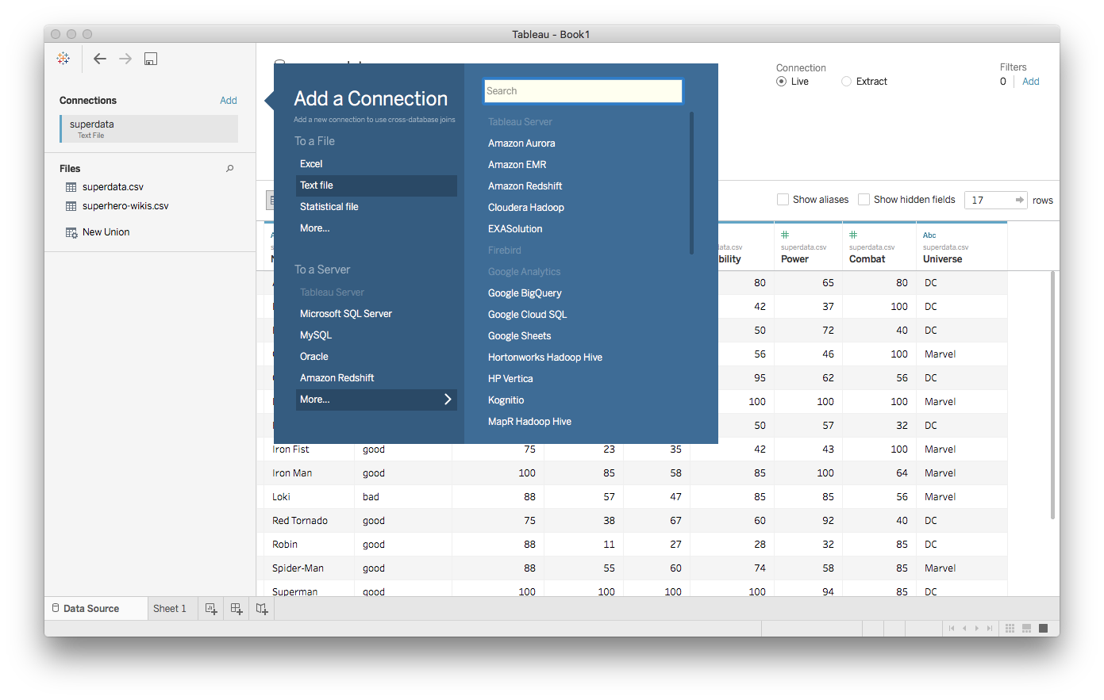
Adding more datasets

Slide 6
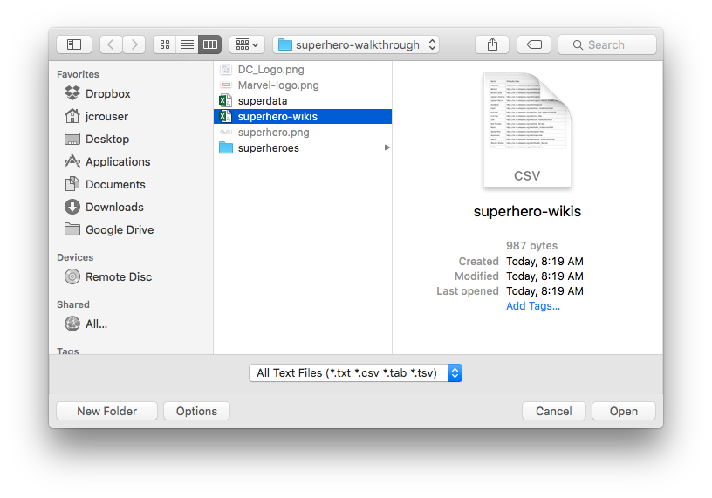
Adding more datasets

Slide 7
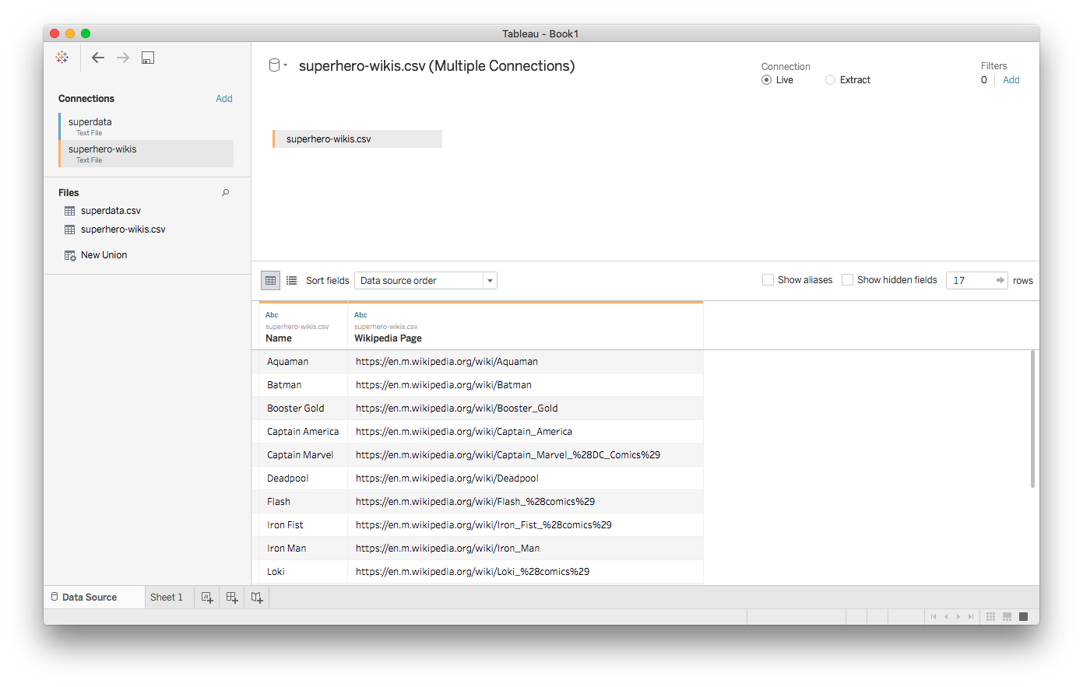
Second dataset: superhero-wikis.csv

Slide 8
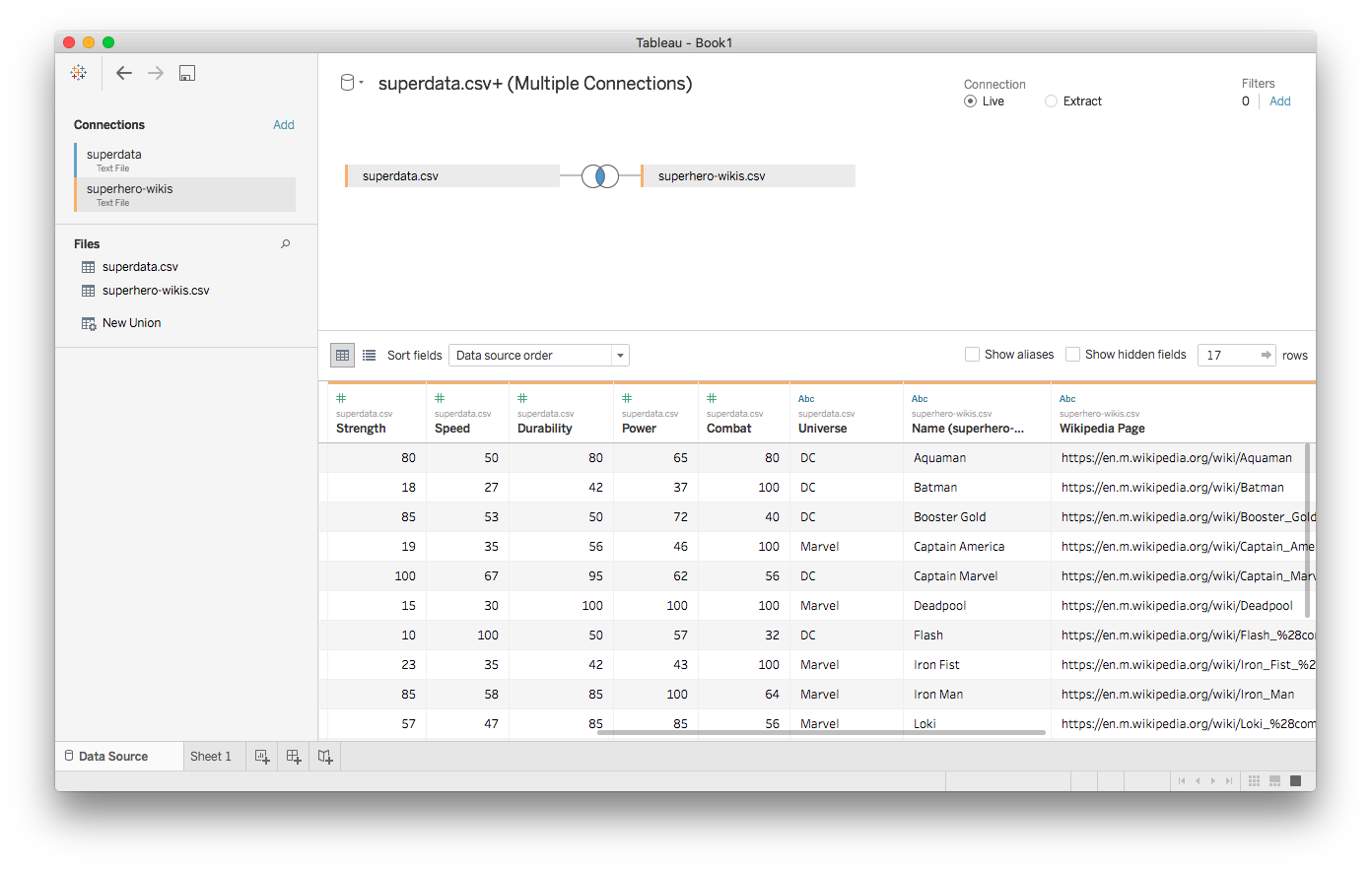
Joining the two

Slide 9
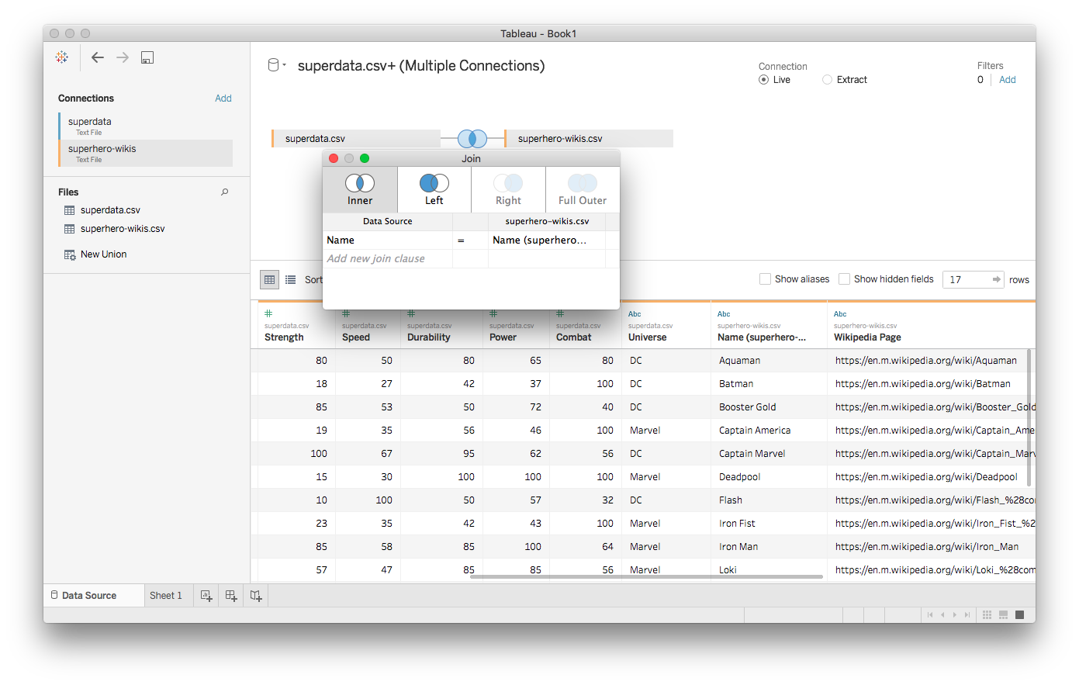
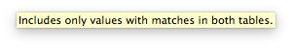
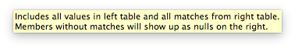
Joining the two
z

Slide 10
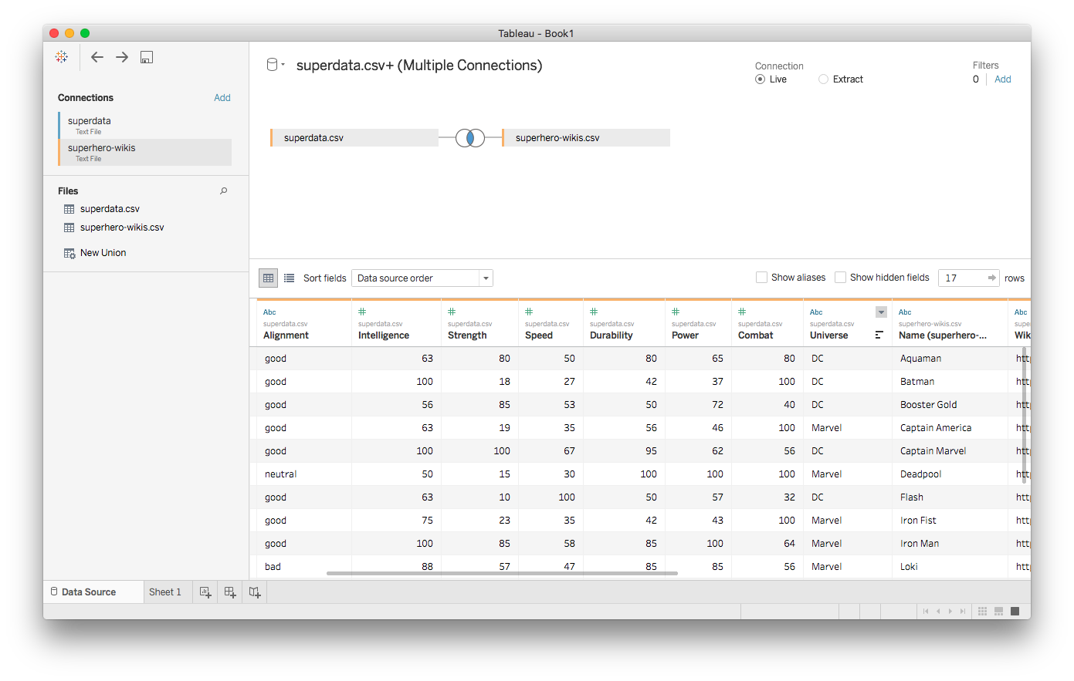
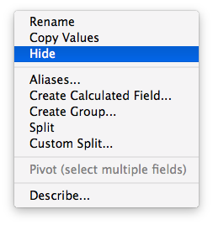
Hiding unnecessary data

Slide 11
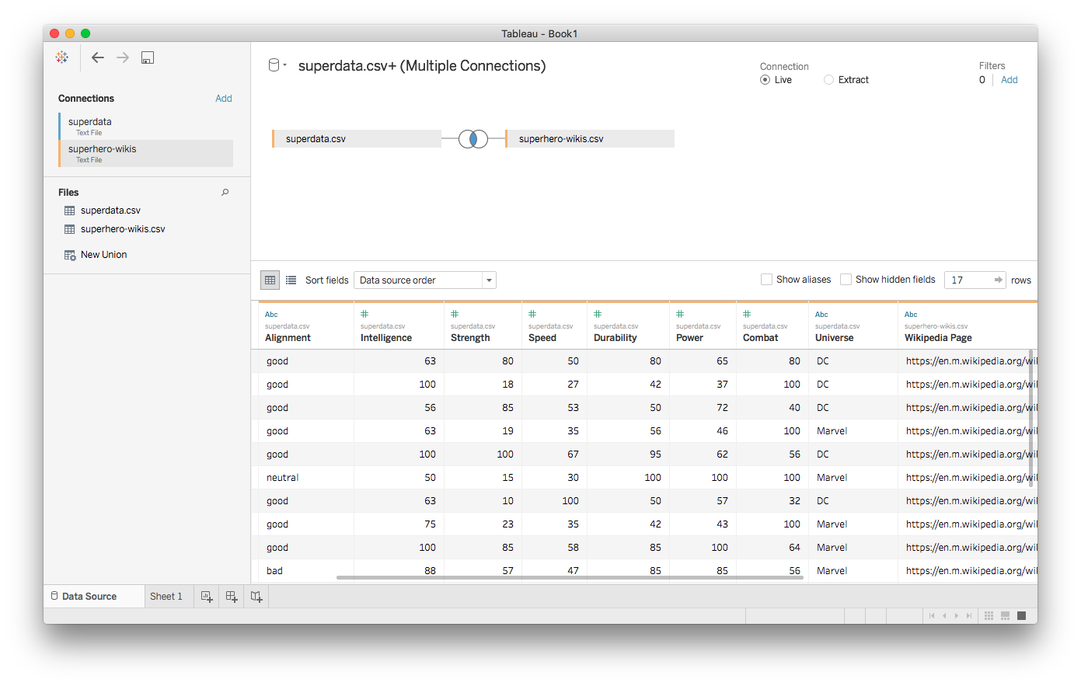
Ready to go!

Slide 12
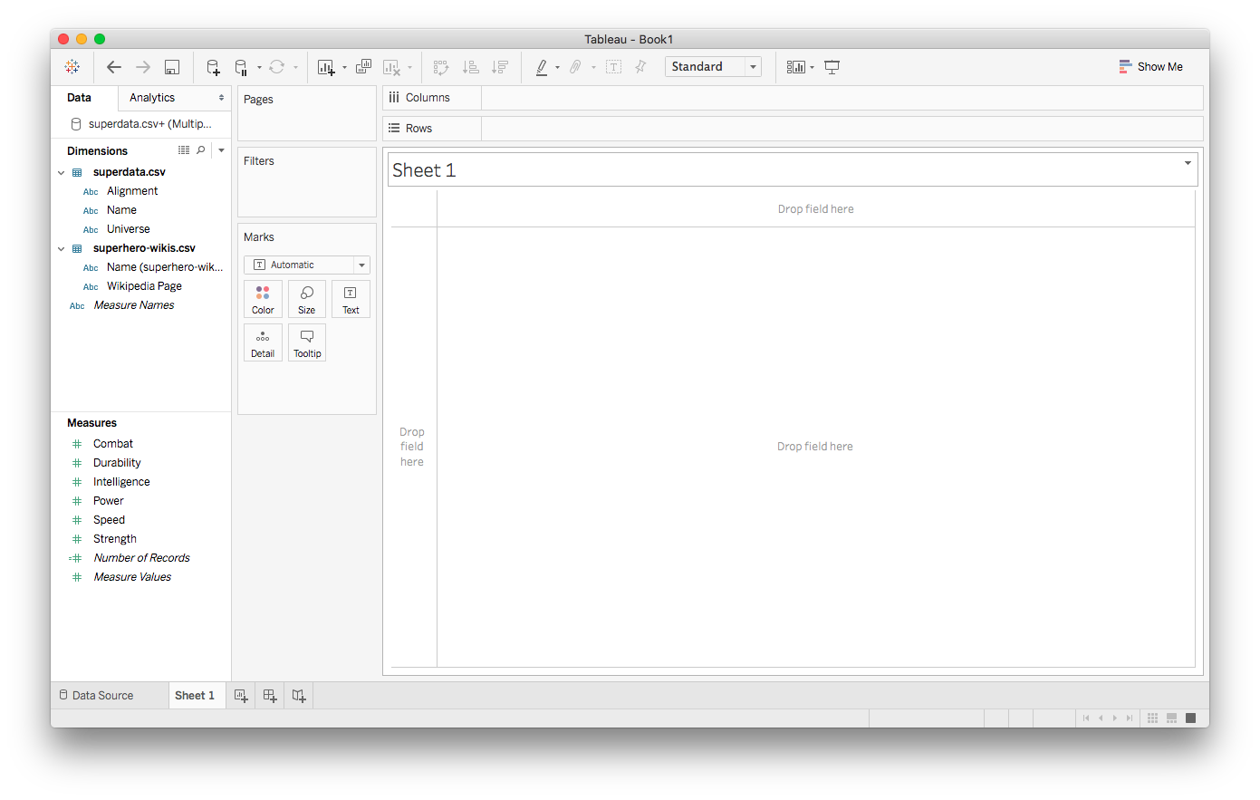
Over to Sheet1

Slide 13
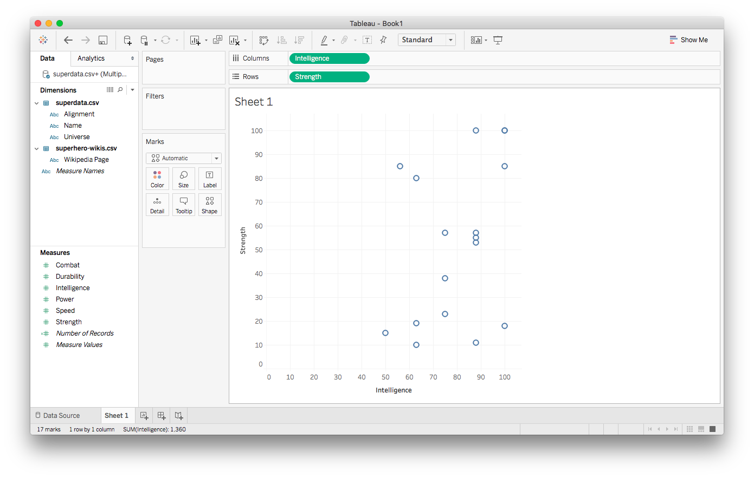
Simple scatterplot

Slide 14
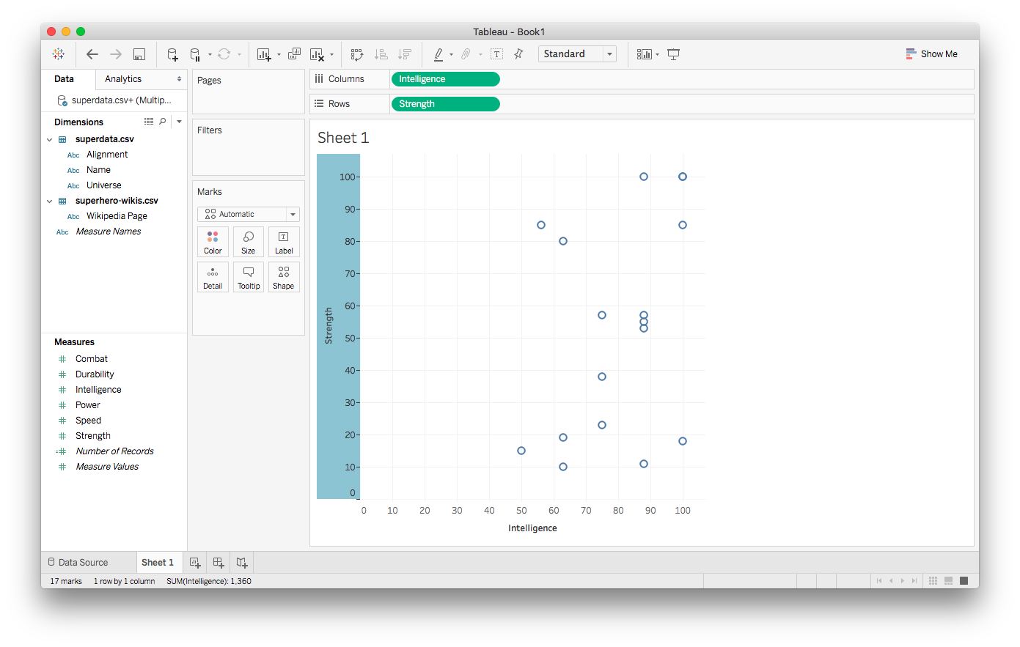
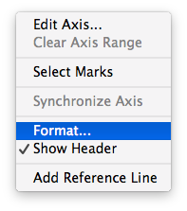
Editing axes

Slide 15
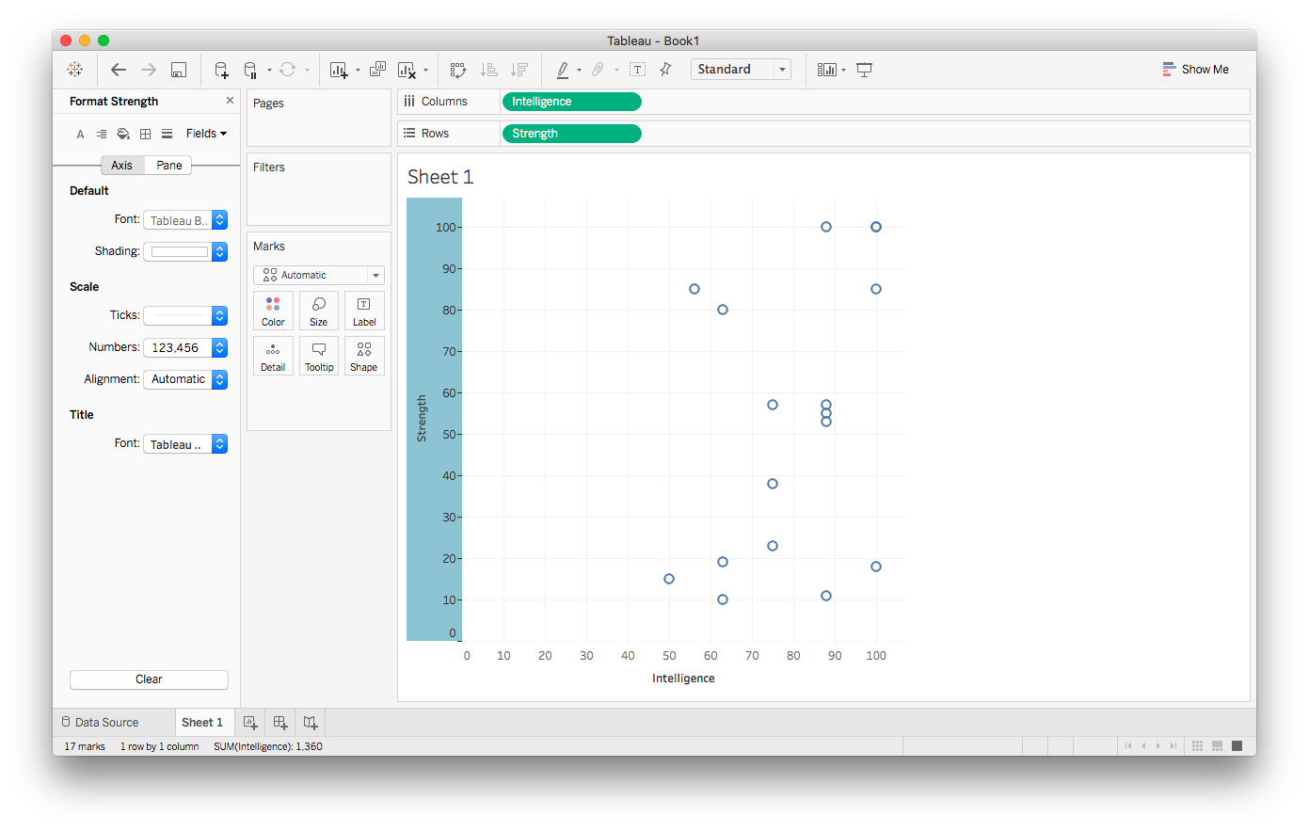
Editing axes

Slide 16
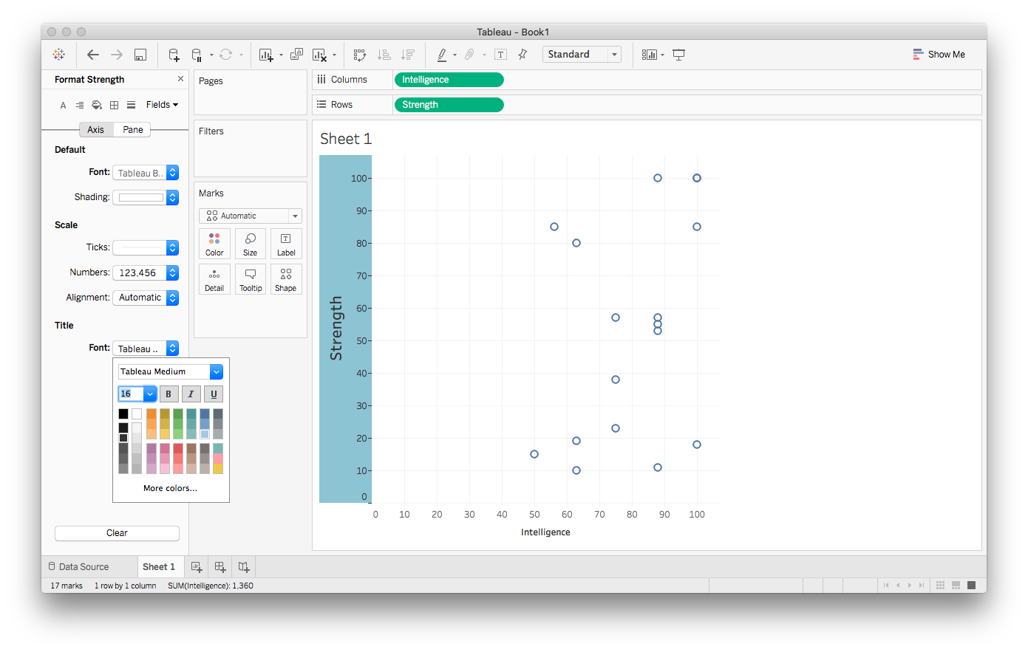
Editing axes

Slide 17
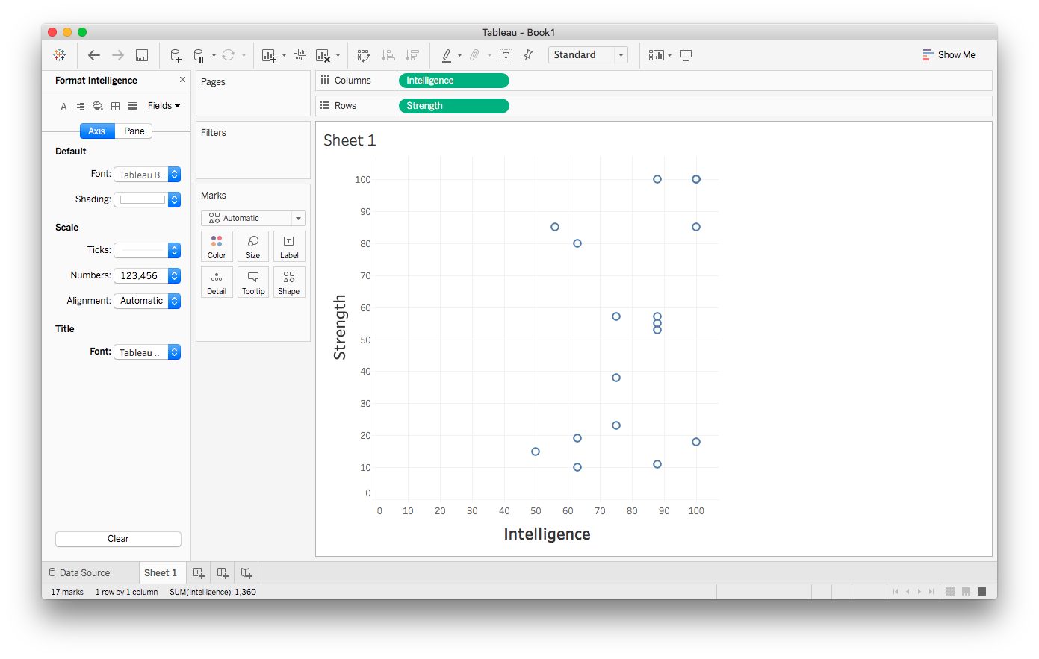
Editing axes

Slide 18
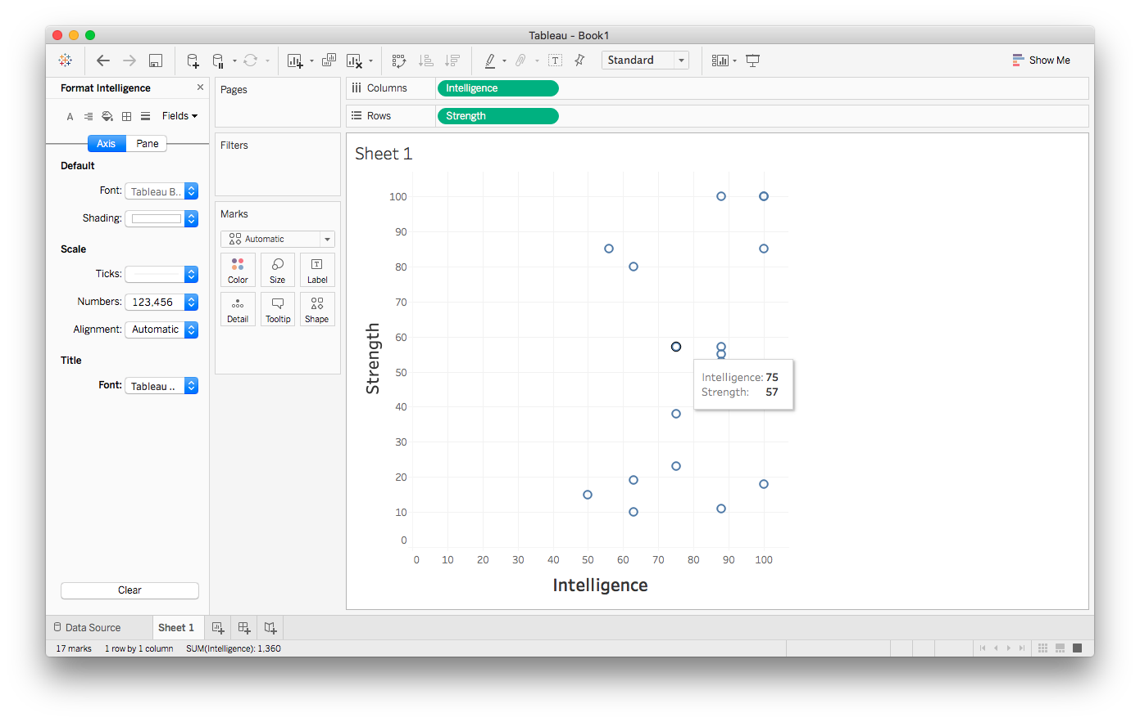
More interesting tooltips

Slide 19
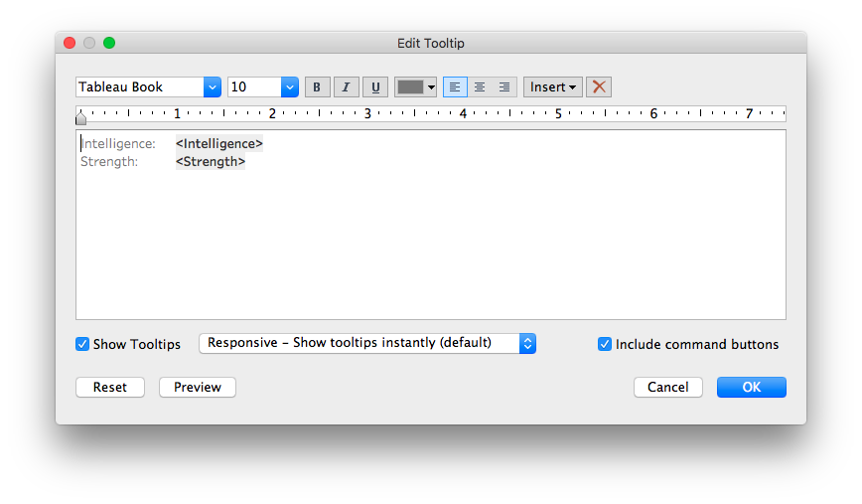
More interesting tooltips

Slide 20
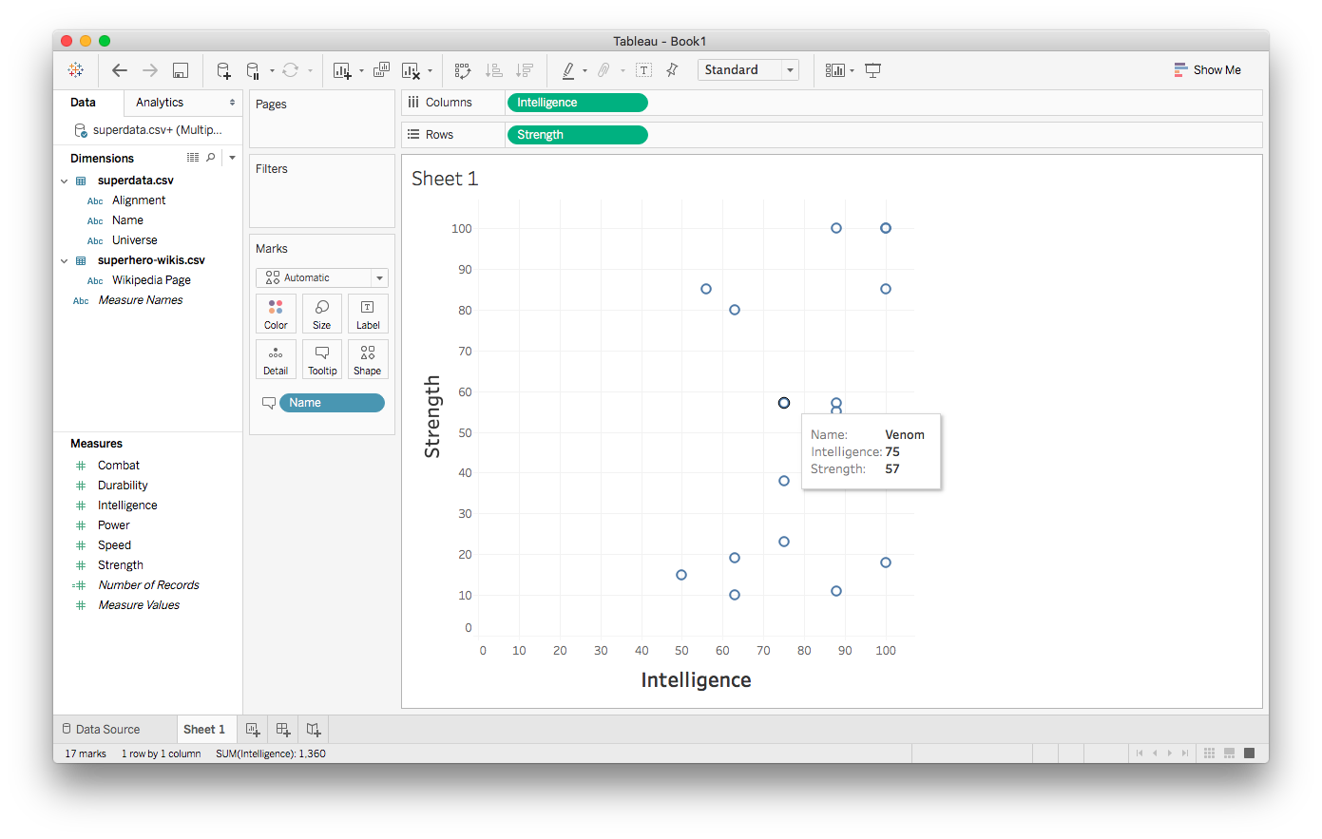
More interesting tooltips

Slide 21
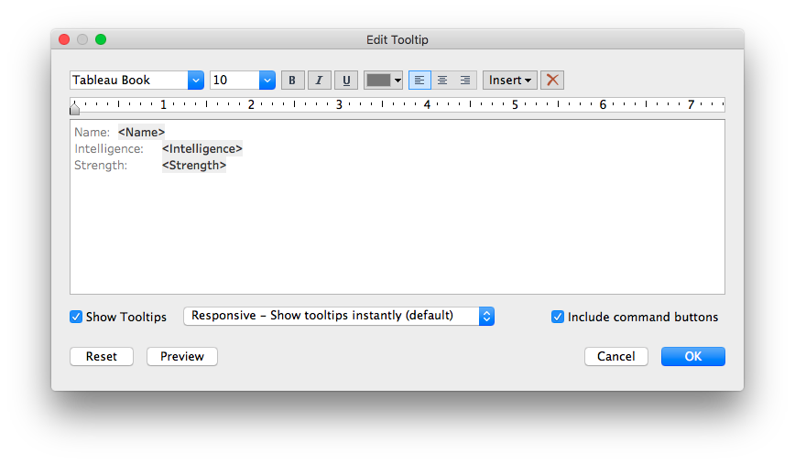
More interesting tooltips

Slide 22
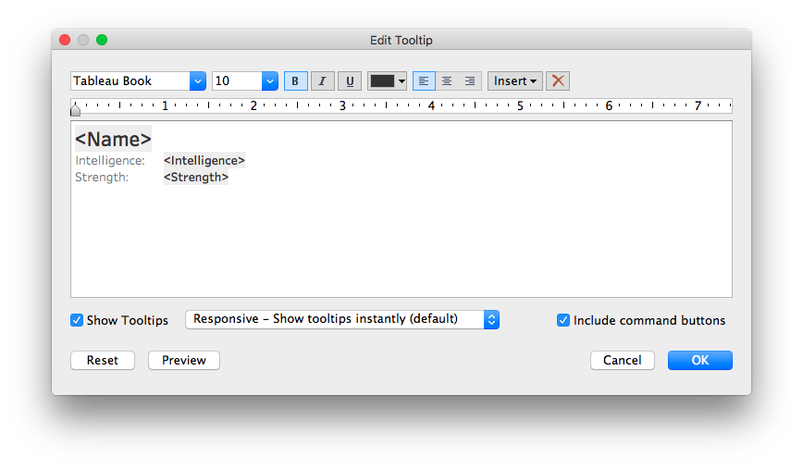
More interesting tooltips

Slide 23
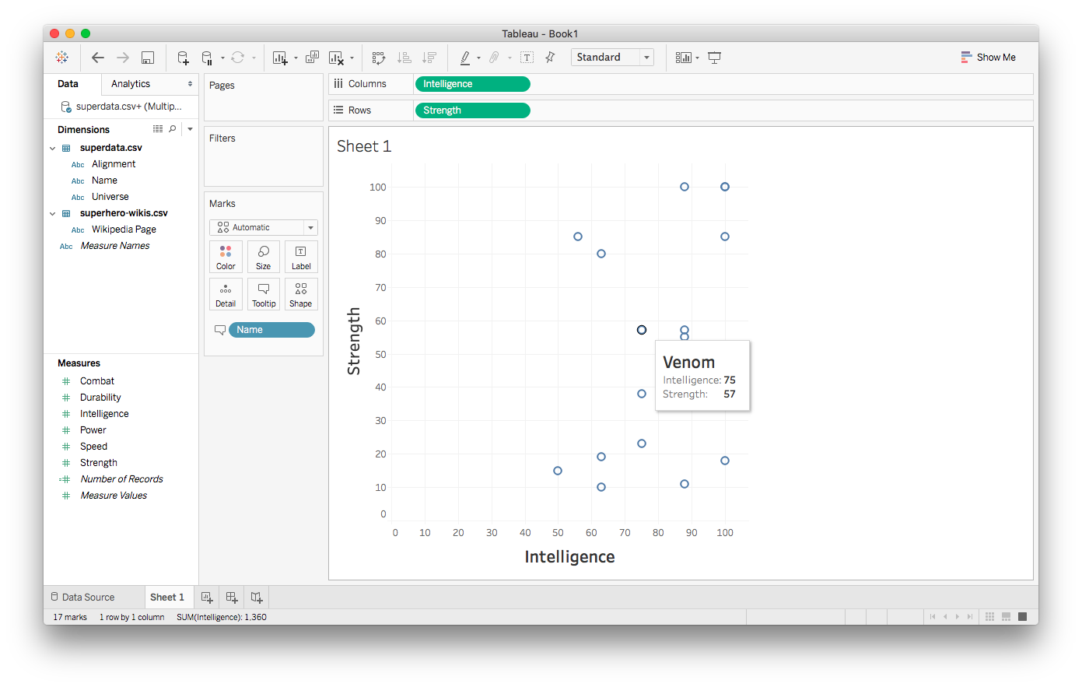
More interesting tooltips

Slide 24
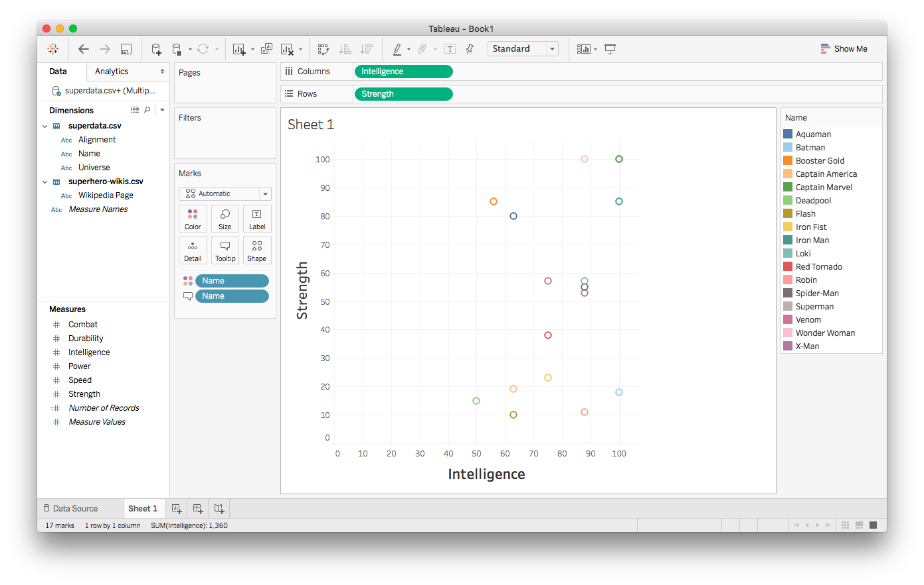
Adding color

Slide 25
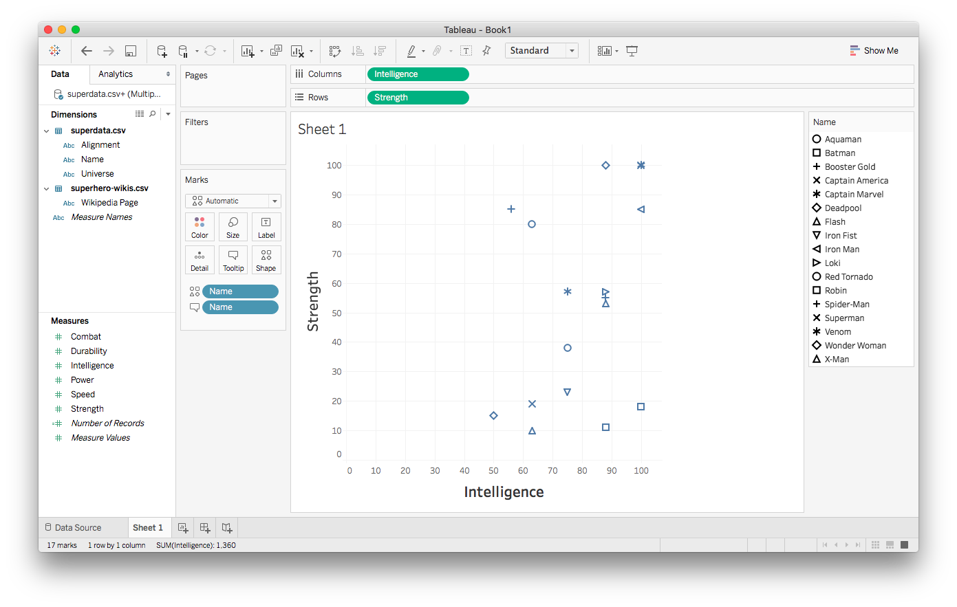
Trying shapes instead

Slide 26
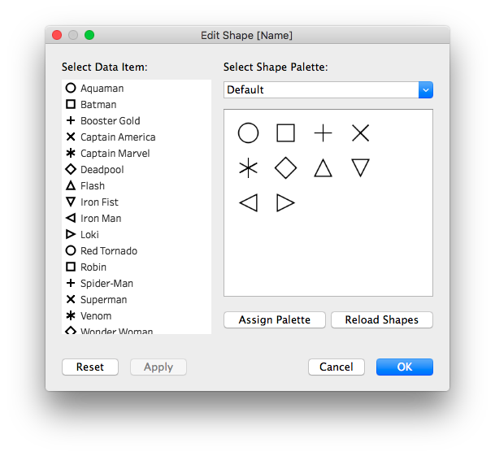
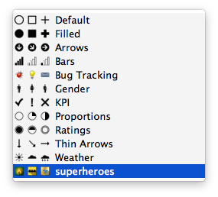
Exploring shapes

Slide 27
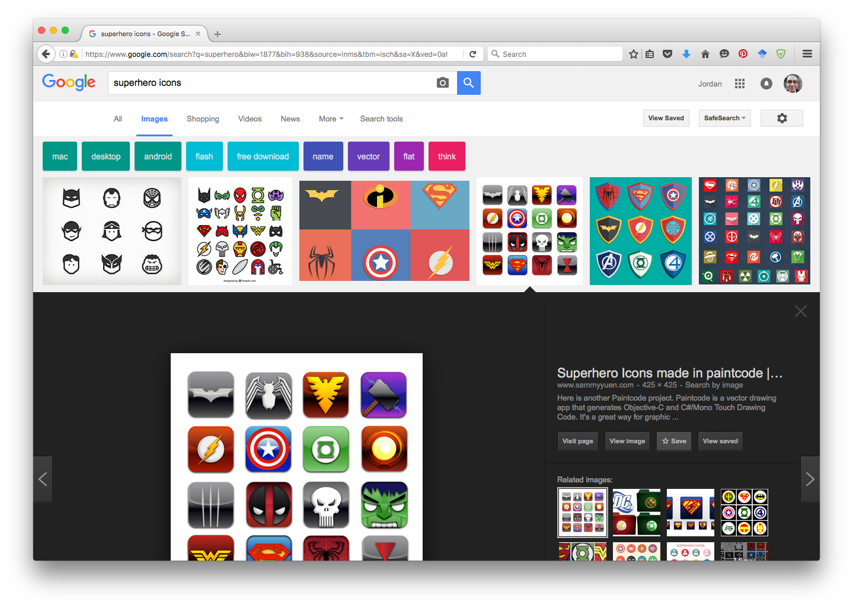
Adding custom shapes

Slide 28
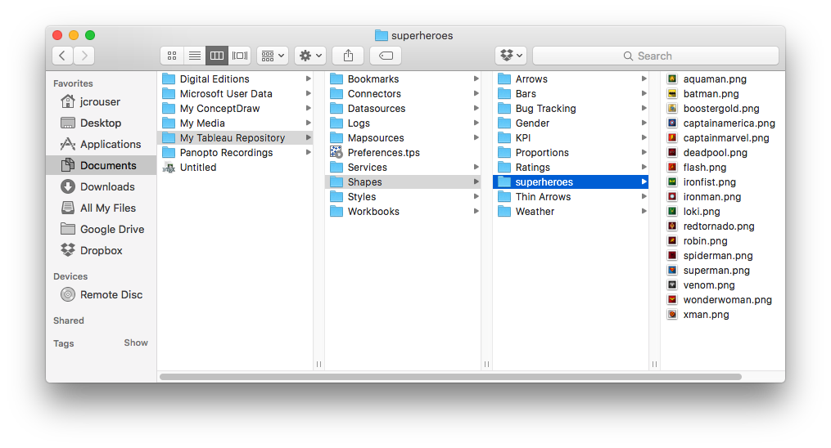
Adding custom shapes

Slide 29

Adding custom shapes

Slide 30
Adding custom shapes

Slide 31
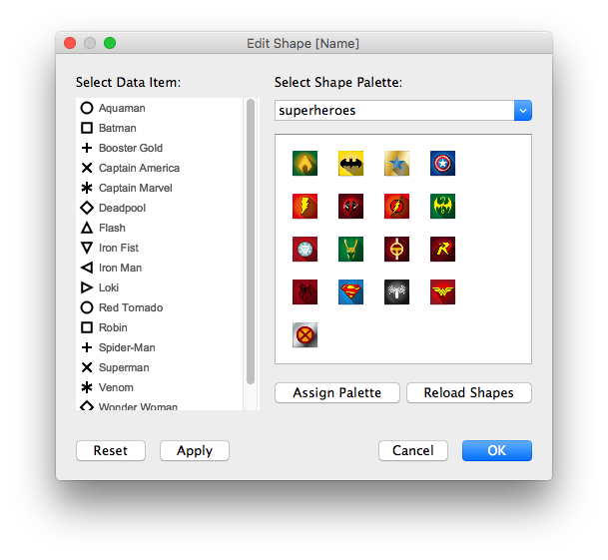
Adding custom shapes

Slide 32
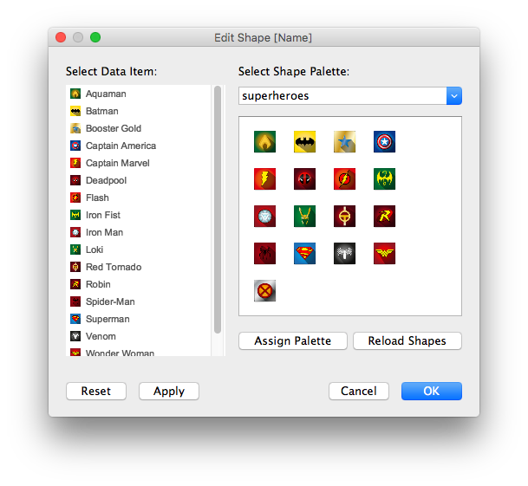
Adding custom shapes

Slide 33
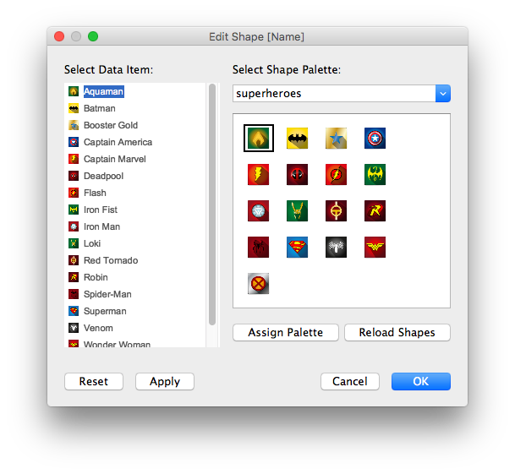
Adding custom shapes

Slide 34
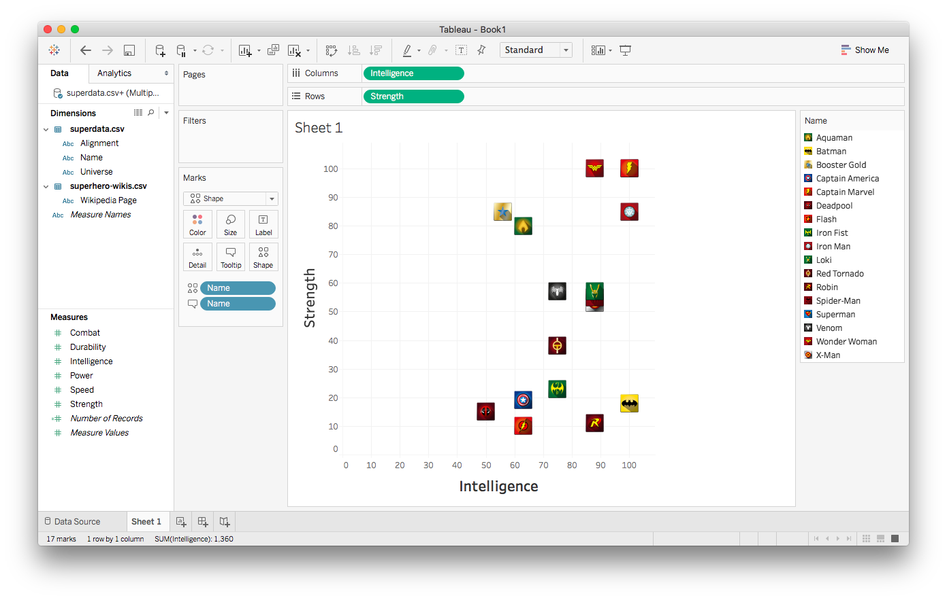
Scatterplot with custom shapes

Slide 35
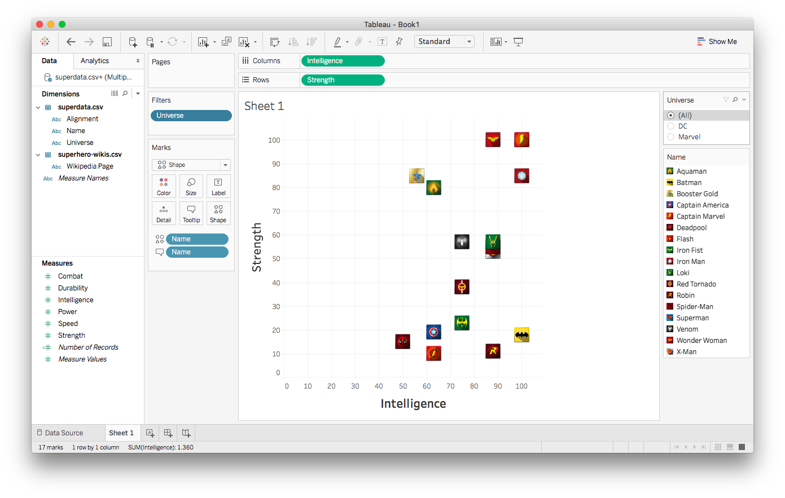
Working with filters

Slide 36
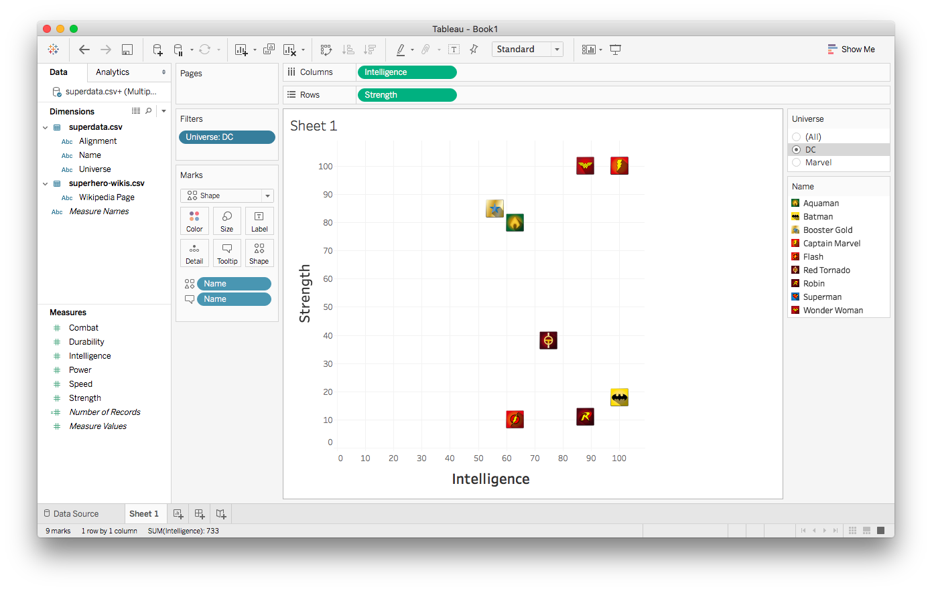
Working with filters

Slide 37
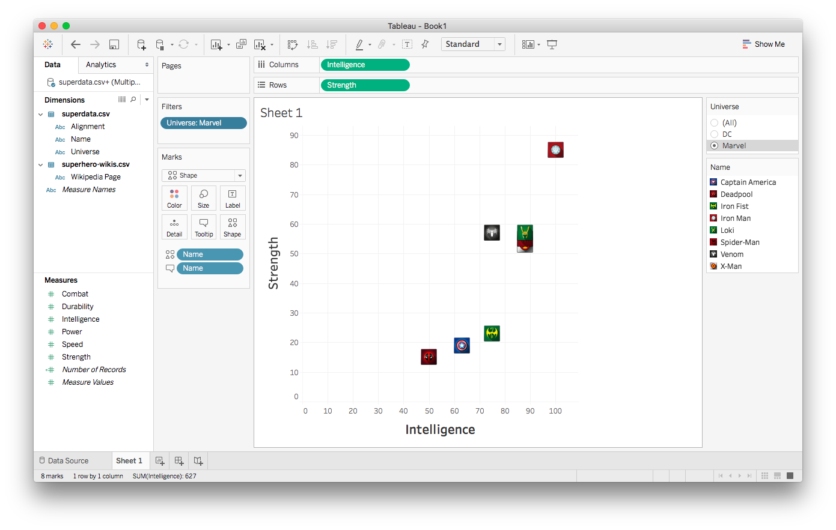
Working with filters

Slide 38
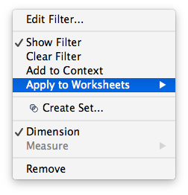
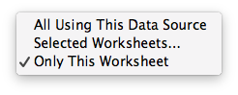
Changing a filter’s scope

Slide 39
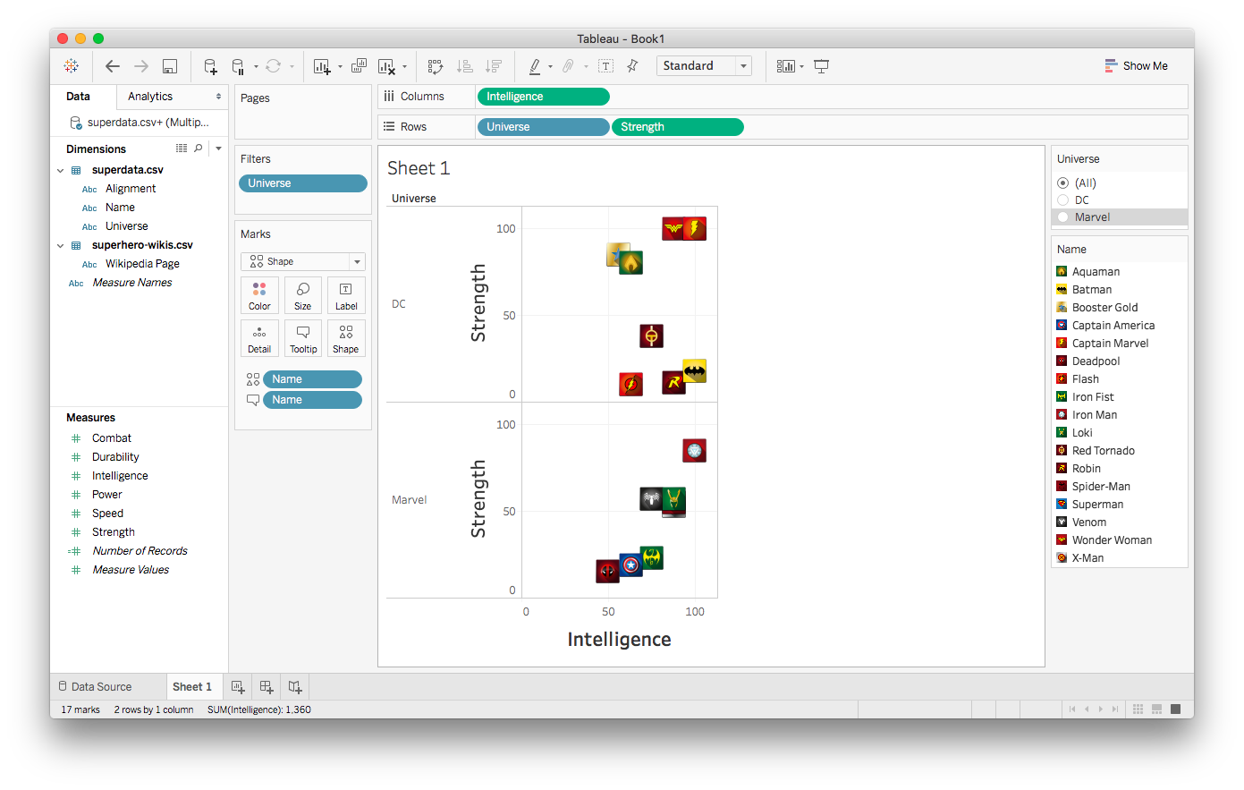
Implicit filtering (side-by-side comparison)

Slide 40


Adding background images

Slide 41
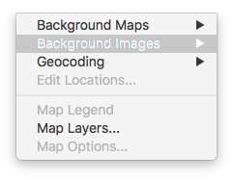
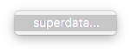
Adding background images

Slide 42
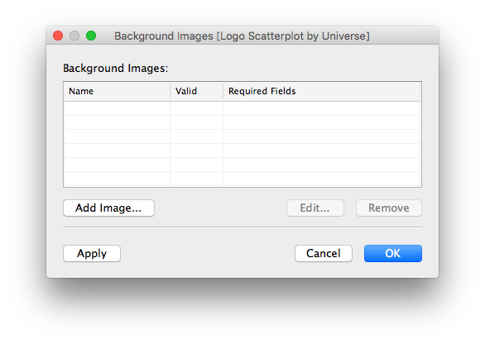
Adding background images

Slide 43
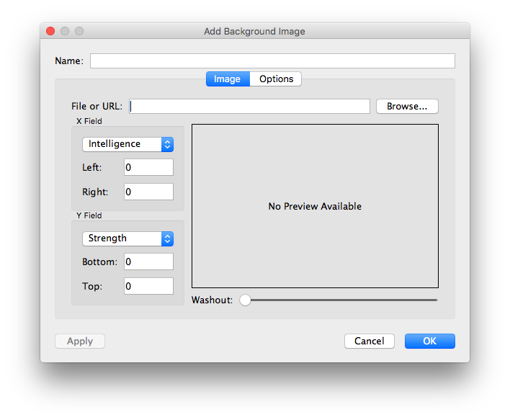
Adding background images

Slide 44
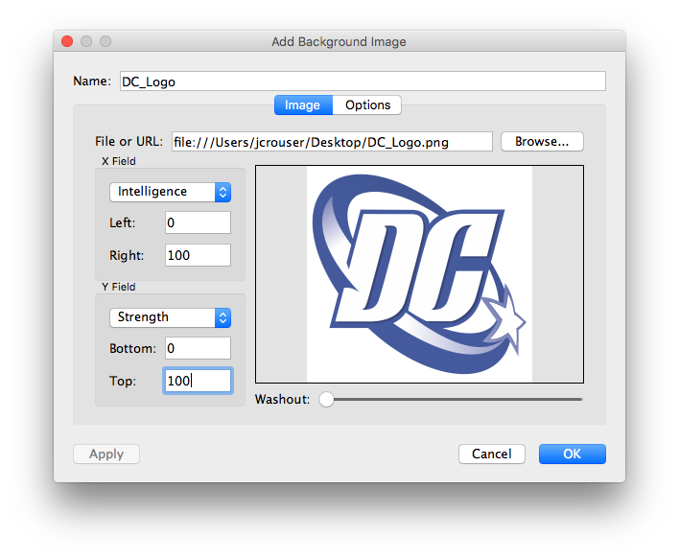
Adding background images

Slide 45
Adding background images

Slide 46
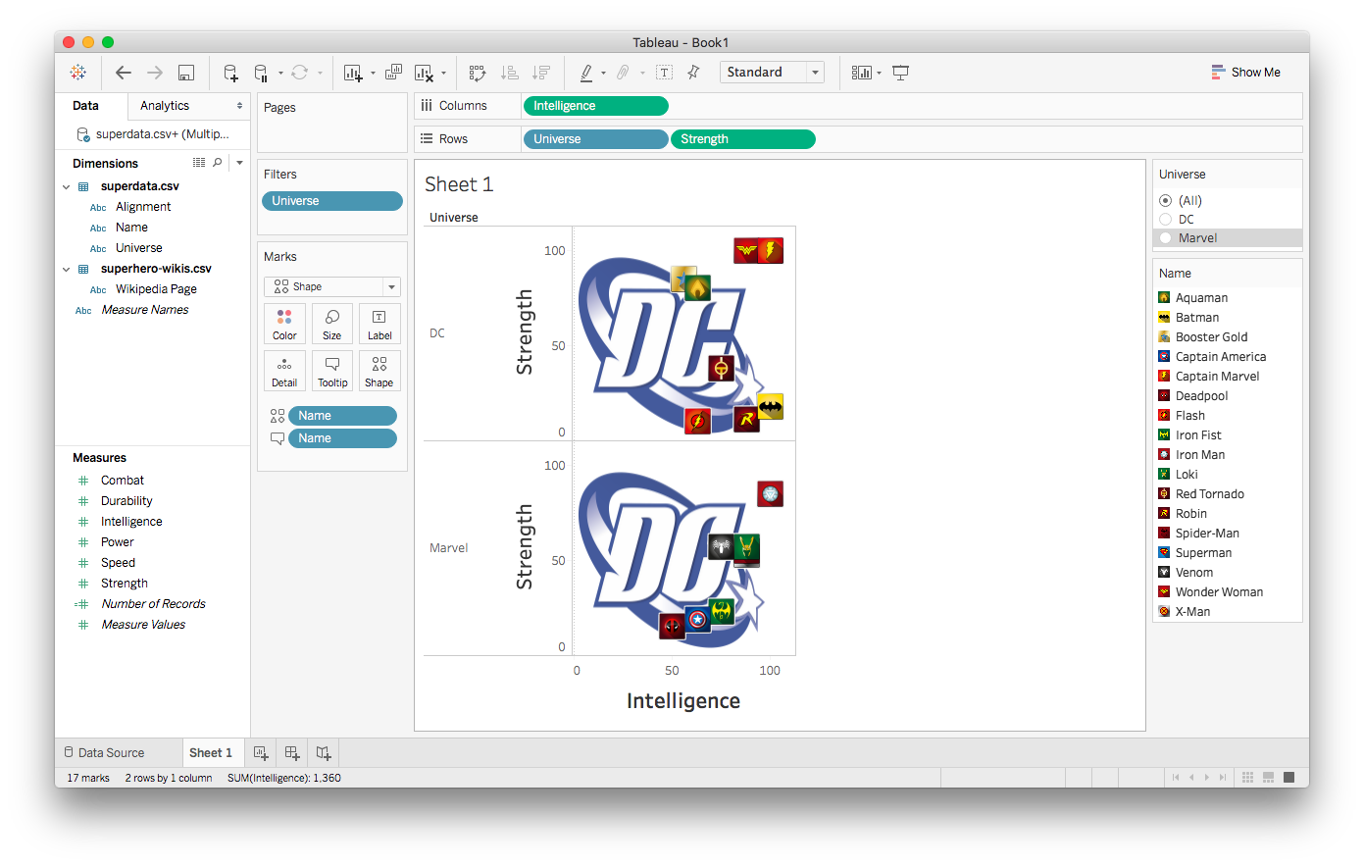
Adding background images

Slide 47
Adding background images

Slide 48
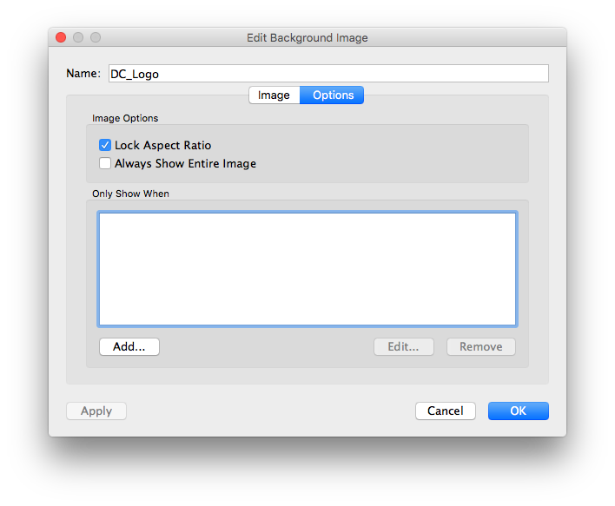
Adding background images

Slide 49
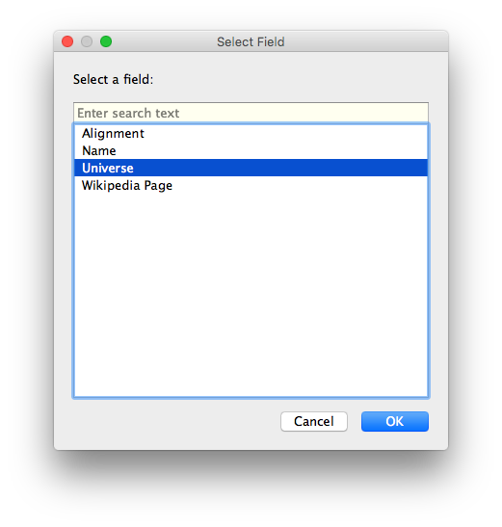
Adding background images

Slide 50
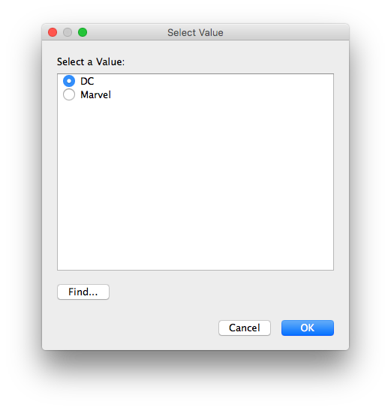
Adding background images

Slide 51

Adding background images

Slide 52

Adding background images

Slide 53

Adding background images

Slide 54

Adding background images

Slide 55

Adding background images

Slide 56

Adding background images

Slide 57

Customizing a dashboard

Slide 58

Customizing a dashboard

Slide 59

Customizing a dashboard

Slide 60

Flashback: dataset

Slide 61

Load external data on click

Slide 62

Load external data on click

Slide 63

Load external data on click

Slide 64

Load external data on click

Slide 65


Load external data on click

Slide 66


Load external data on click

Slide 67

Load external data on click

Slide 68

Load external data on click

Slide 69

Load external data on click

Slide 70
Load external data on click

Slide 71

Load external data on click

Slide 72

Load external data on click

Slide 73
Multiple datasets
Customizing the look of a visualization
Adding custom icon sets
Working with filters
Conditional backgrounds
Adding images
Details on demand (external resources)
Recap

